Slide 1
Recipes App Software Lab IV
Srijani Bheemarapu
BT20CSE128
Android development [ React Native]

Slide 2
ABOUT
Create an android development project using React Native
Recipe App is a guide book for food lover who are interested in trying new recipes and explore new cooking skills.
Recipe app allow users to easily organize their favorite recipes in one place
Recipe apps provide users with new and interesting recipes to try.

Slide 3
Overview React-Native
React Native is an open-source framework that allows developers to build mobile applications for iOS, Android, and other platforms using JavaScript and React.
React native is easy to learn and faster to implement since its code is reusable on different platforms.
It provides a smooth and responsive user interface with set of components that map to native UI components, making it easy for developers to create a native look and feel for their apps.
It is a frontend framework.
React Native is Community-driven. Maximum code reuse & cost saving. Strong performance for mobile environments

Slide 4

Expo
Expo is an open-source framework for apps that run natively on Android, iOS, and the web.
The expo-npm package enables a suite of incredible features for React Native apps.
The expo package provides a small and powerful CLI tool which is designed to keep you moving fast during app development.
Npm
npm is a node package manager for the JavaScript programming language.
It's a library and registry for JavaScript software packages.
Why react native? It provides a slick, smooth and responsive user interface, while significantly reducing load time

Slide 5
Installation and Setting
The first step is to download the respective packages and dependencies for this project.
Install Node.js : v18.12.1.
s
Next Download expo and initialize the application.
command: npm I –g expo-cli
expo init first
Also download the expo-go app from playstore on your mobile phones.
Go to your expo file that you just created using the cd command.
Now on the terminal type the command: npm start
This now starts a server for the native application.
Since this app runs on an android device we scan the QR it generates on the expo app on our mobiles.

Slide 6

FEATURES
Recipes List
Categories
Ingredients
Recipes Details Screen
Photo Gallery
Detailed Description
Ingredients button
Ingredients List
Recipes by Ingredient
Search
Drawer Menu
Navigation Bar
Beautiful UI Design Kit
Compatible with Expo
Highly modularized codebase

Slide 7
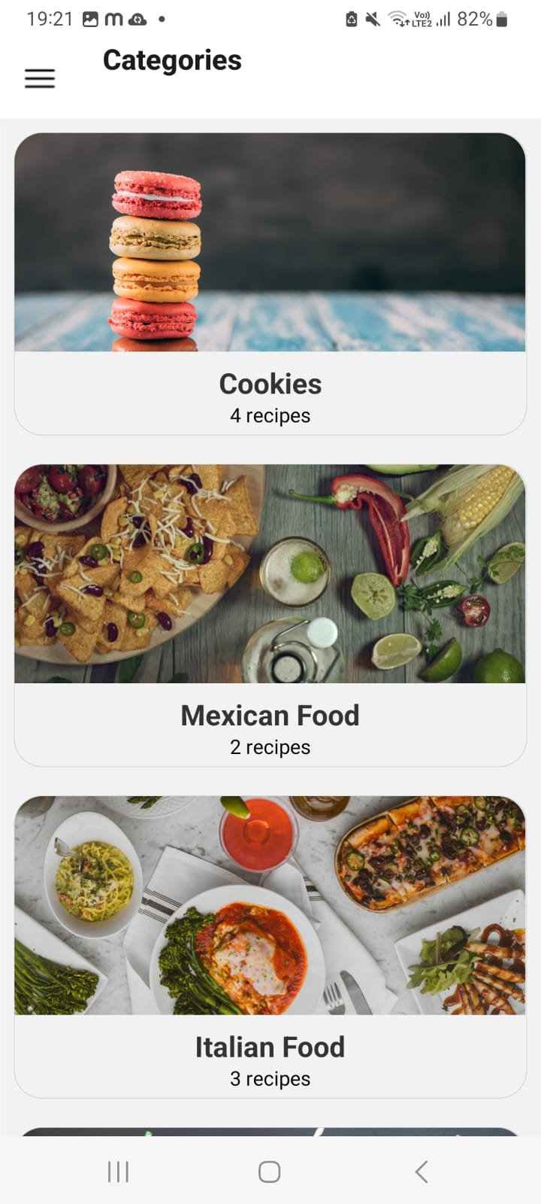
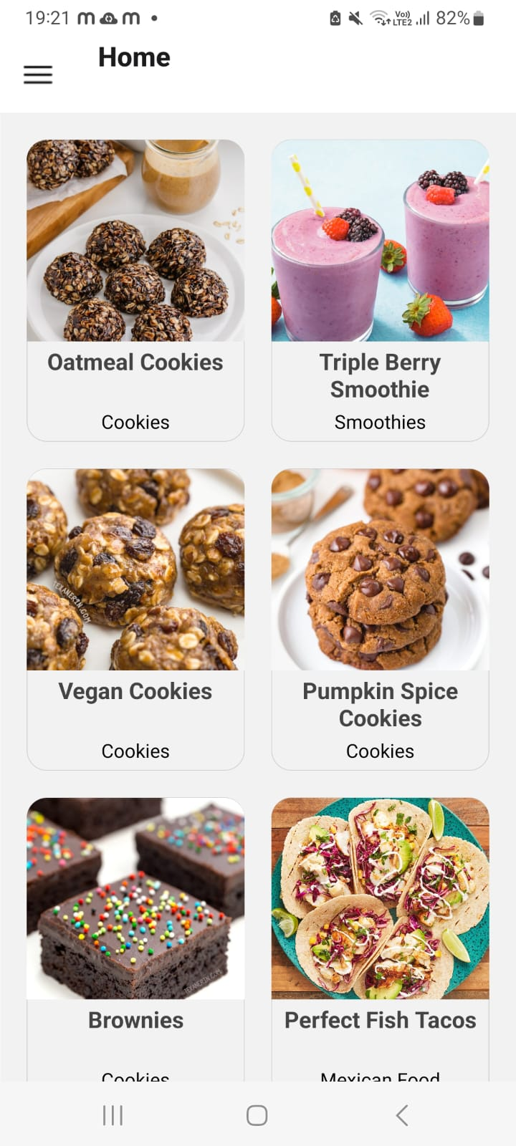
Home and Category Screen

Slide 8
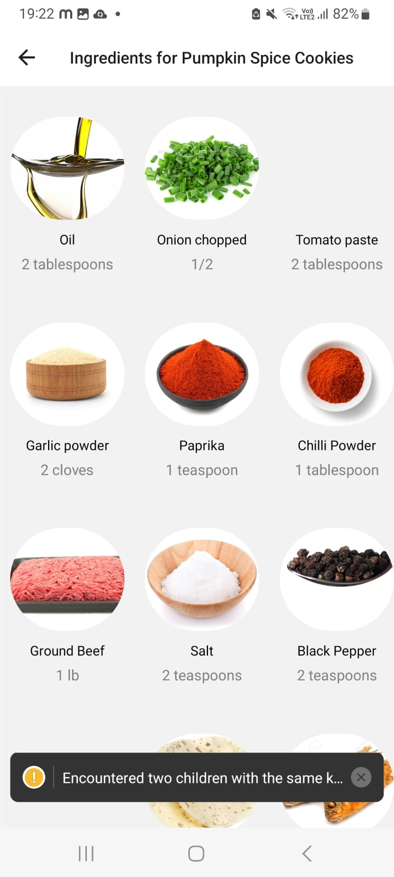
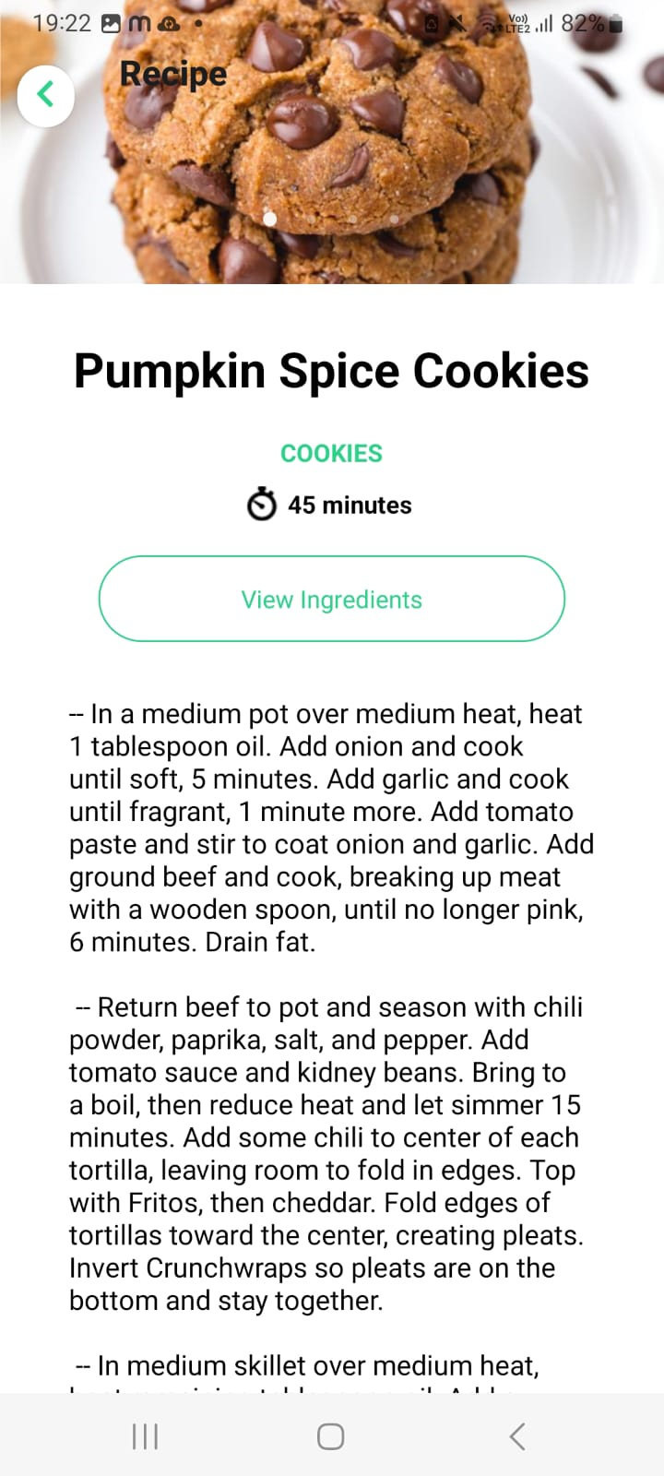

Slide 9
ThANK YOU

